Slide 1
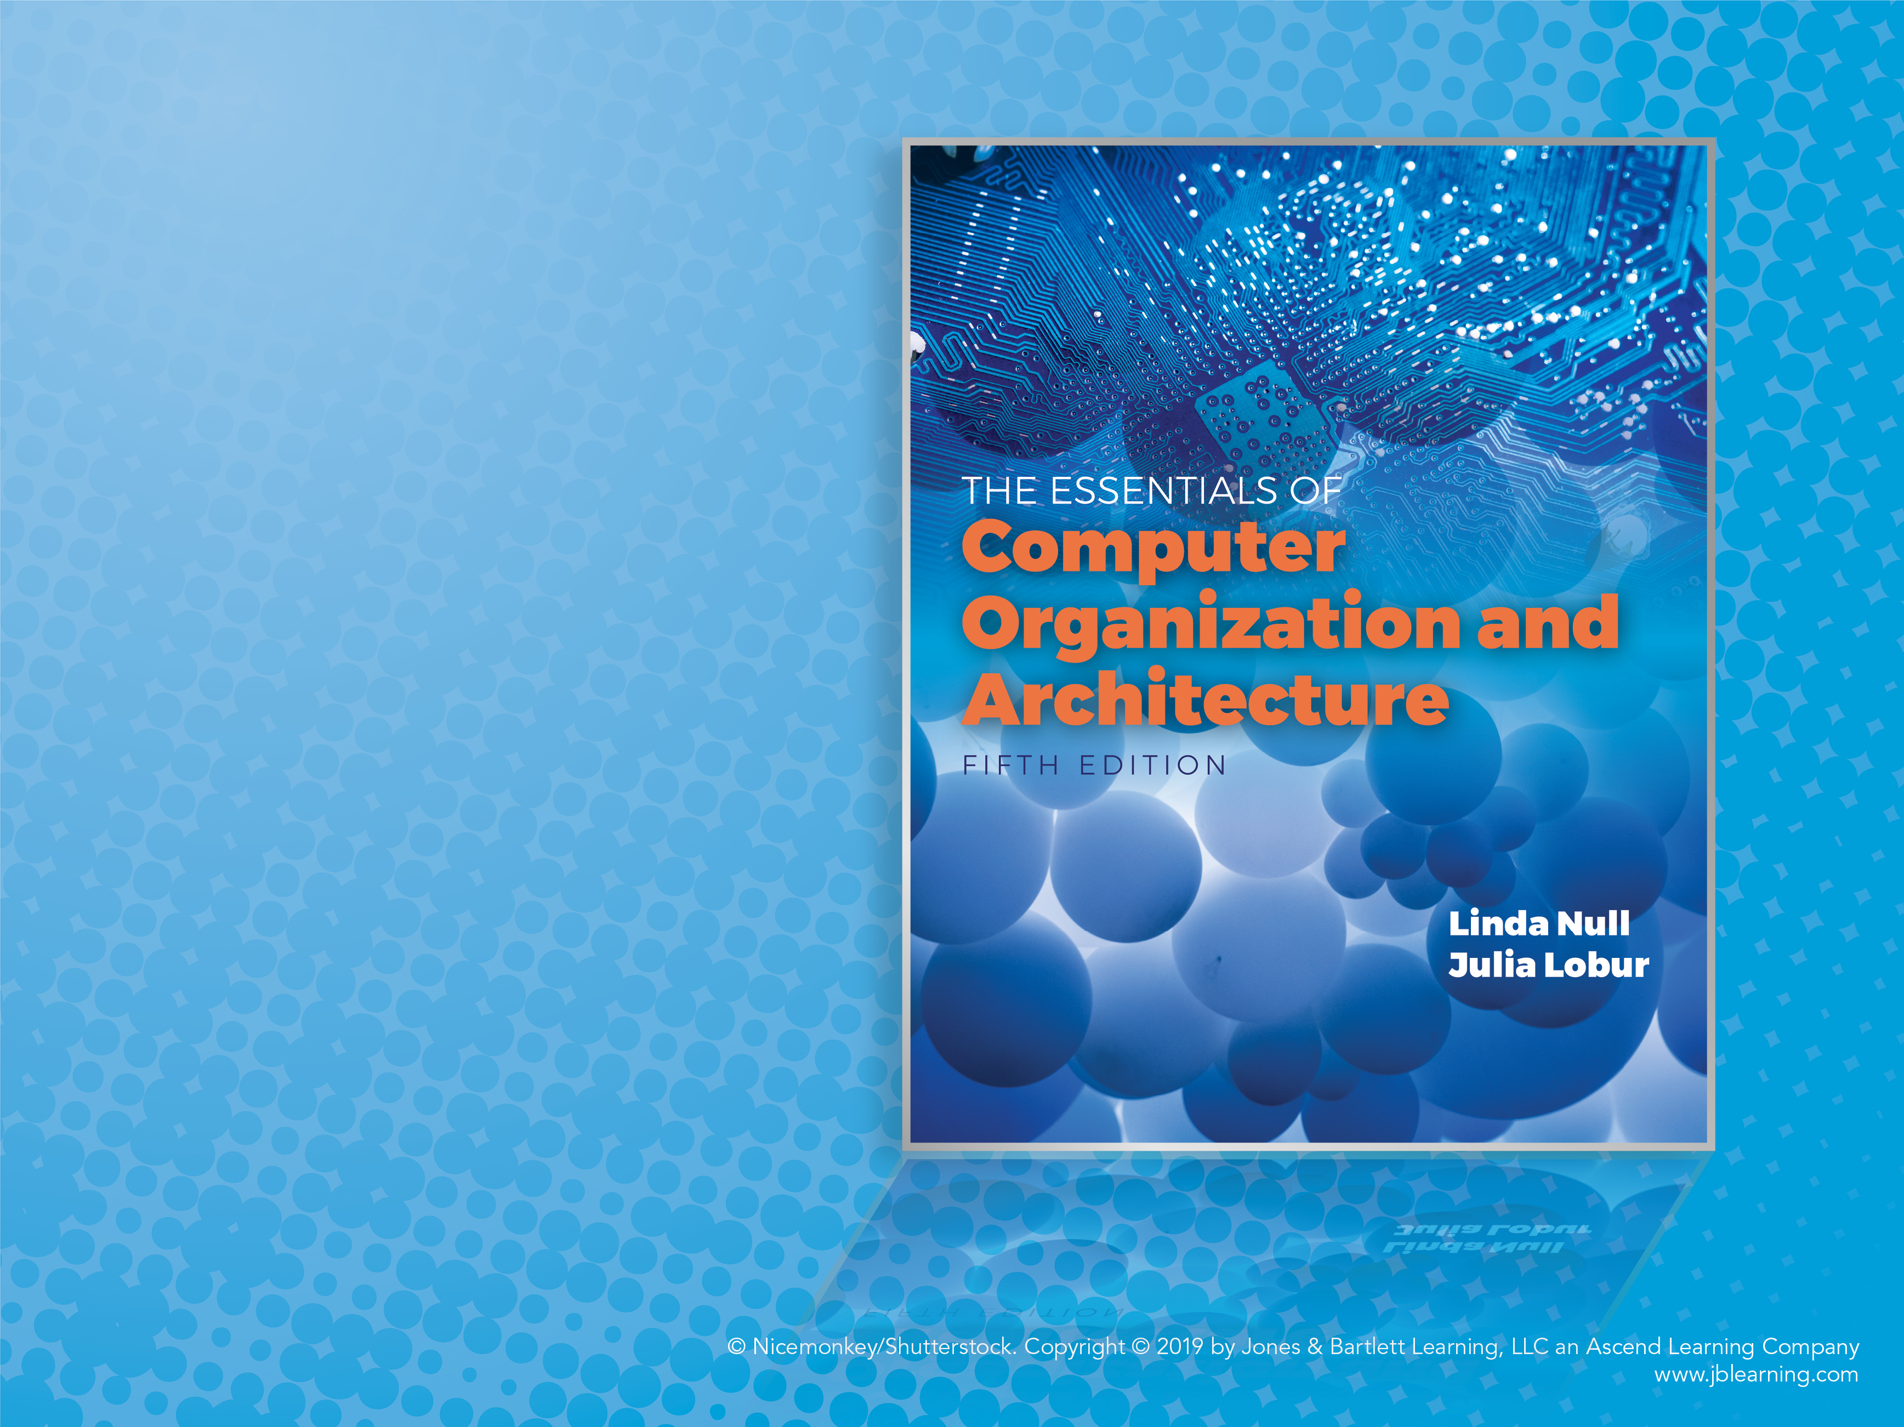
Chapter 1
Introduction

Slide 2
Objectives
Know the difference between computer organization and computer architecture.
Understand units of measure common to computer systems.
Appreciate the evolution of computers.
Understand the computer as a layered system.
Be able to explain the von Neumann architecture and the function of basic computer components.

Slide 3
1.1 Overview (1 of 2)
Why study computer organization and architecture?
Design better programs, including system software such as compilers, operating systems, and device drivers.
Optimize program behavior.
Evaluate (benchmark) computer system performance.
Understand time, space, and price tradeoffs.

Slide 4
1.1 Overview (2 of 2)
Computer organization
Encompasses all physical aspects of computer systems (e.g., circuit design, control signals, memory types).
How does a computer work?
Computer architecture
Logical aspects of system implementation as seen by the programmer (e.g., instruction sets, instruction formats, data types, addressing modes).
How do I design a computer?

Slide 5
1.2 Computer Systems (1 of 2)
There is no clear distinction between matters related to computer organization and matters relevant to computer architecture.
Principle of Equivalence of Hardware and Software:
Any task done by software can also be done using hardware, and any operation performed directly by hardware can be done using software.*
* Assuming speed is not a concern.

Slide 6
1.2 Computer Systems (2 of 2)
At the most basic level, a computer is a device consisting of three pieces:
A processor to interpret and execute programs
A memory to store both data and programs
A mechanism for transferring data to and from the outside world

Slide 7
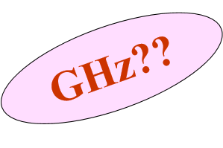
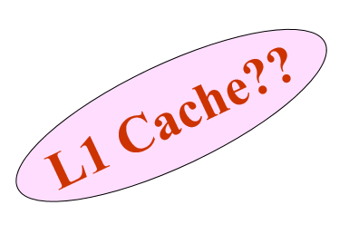
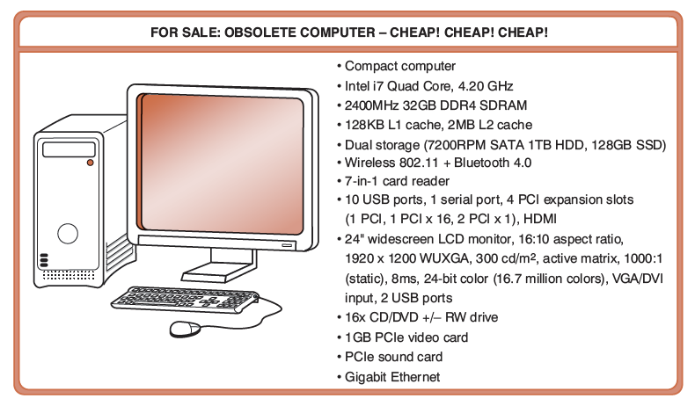
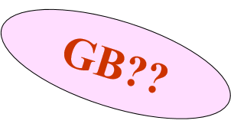
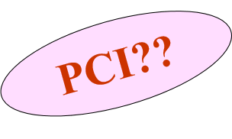

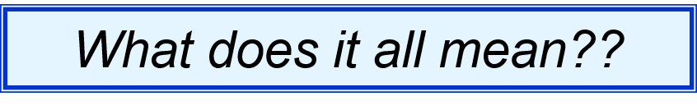
1.3 An Example System (1 of 19)
Consider this advertisement:

Slide 8
1.3 An Example System (2 of 19)
Measures of capacity and speed:
Kilo- (K) = 1 thousand = 10³ and 2¹⁰
Mega- (M) = 1 million = 10⁶ and 2²⁰
Giga- (G) = 1 billion = 10⁹ and 2³⁰
Tera- (T) = 1 trillion = 10¹² and 2⁴⁰
Peta- (P) = 1 quadrillion = 10¹⁵ and 2⁵⁰
Exa- (E) = 1 quintillion = 10¹⁸ and 2⁶⁰
Zetta- (Z) = 1 sextillion = 10²¹ and 2⁷⁰
Yotta- (Y) = 1 septillion = 10²⁴ and 2⁸⁰
Whether a metric refers to a power of ten or a power of two typically depends upon what is being measured.

Slide 9
1.3 An Example System (3 of 19)
Hertz = clock cycles per second (frequency)
1MHz = 1,000,000Hz
Processor speeds are measured in MHz or GHz.
Byte = a unit of storage
1KB = 2¹⁰ = 1024 Bytes
1MB = 2²⁰ = 1,048,576 Bytes
1GB = 2³⁰ = 1,099,511,627,776 Bytes
Main memory (RAM) is measured in GB.
Disk storage is measured in GB for small systems, TB (2⁴⁰) for large systems.

Slide 10
1.3 An Example System (4 of 19)
Measures of time and space:
Milli- (m) = 1 thousandth = 10⁻³
Micro- (μ) = 1 millionth = 10⁻⁶
Nano- (n) = 1 billionth = 10⁻⁹
Pico- (p) = 1 trillionth = 10⁻¹²
Femto- (f) = 1 quadrillionth = 10⁻¹⁵
Atto- (a) = 1 quintillionth = 10⁻¹⁸
Zepto- (z) = 1 sextillionth = 10⁻²¹
Yocto- (y) = 1 septillionth = 10⁻²⁴

Slide 11
1.3 An Example System (5 of 19)
Millisecond = 1 thousandth of a second
Hard disk drive access times are often 10 to 20 milliseconds.
Nanosecond = 1 billionth of a second
Main memory access times are often 50 to 70 nanoseconds.
Micron (micrometer) = 1 millionth of a meter
Circuits on computer chips are measured in microns.

Slide 12
1.3 An Example System (6 of 19)
We note that cycle time is the reciprocal of clock frequency.
A bus operating at 133MHz has a cycle time of 7.52 nanoseconds:
133,000,000 cycles/second = 7.52 ns/cycle
Now back to the advertisement ...

Slide 13

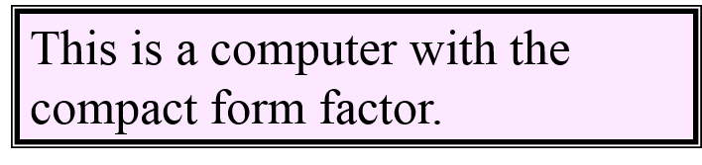
1.3 An Example System (7 of 19)

Slide 14
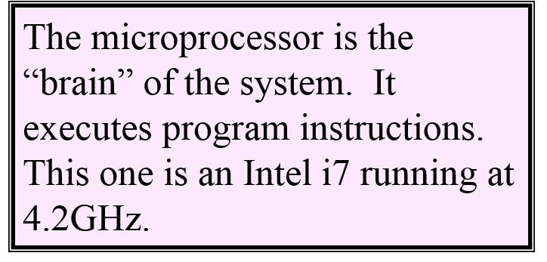
1.3 An Example System (8 of 19)

Slide 15
1.3 An Example System (9 of 19)
Computers with large main memory capacity can run larger programs with greater speed than computers having small memories.
RAM is an acronym for random access memory. Random access means that memory contents can be accessed directly if you know its location.
Cache is a type of temporary memory that can be accessed faster than RAM.

Slide 16
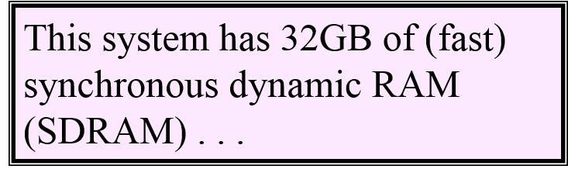


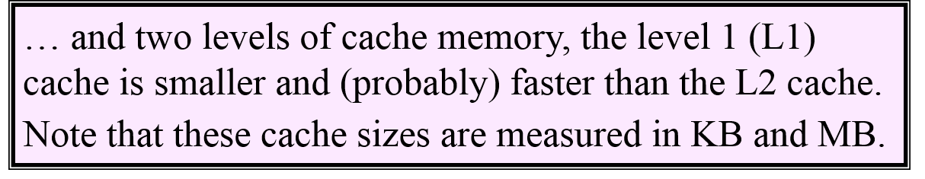
1.3 An Example System (10 of 19)

Slide 17
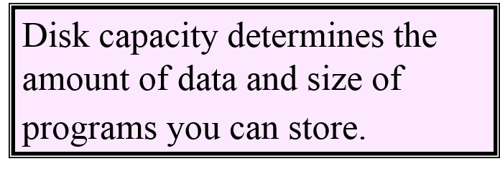

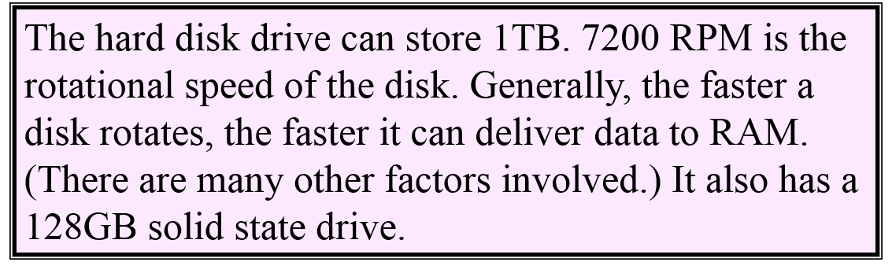
1.3 An Example System (11 of 19)

Slide 18
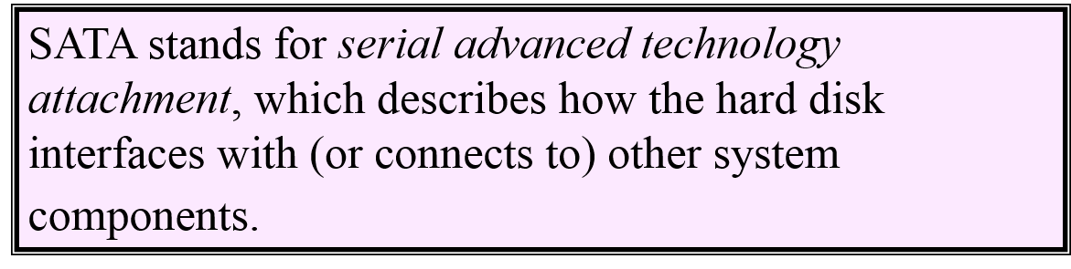
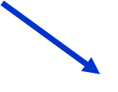

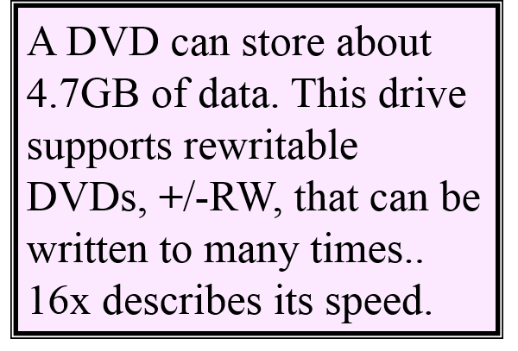
1.3 An Example System (12 of 19)

Slide 19
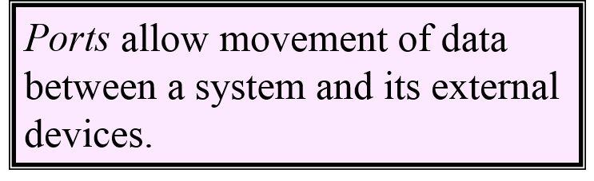

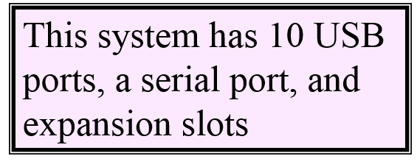
1.3 An Example System (13 of 19)

Slide 20
1.3 An Example System (14 of 19)
Serial ports send data as a series of pulses along one or two data lines.
Parallel ports send data as a single pulse along at least eight data lines.
USB, Universal Serial Bus, is an intelligent serial interface that is self-configuring. (It supports “plug and play.”)

Slide 21
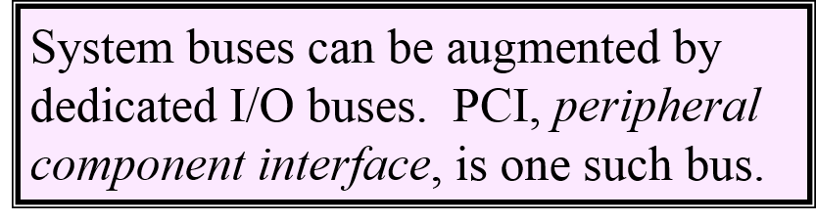
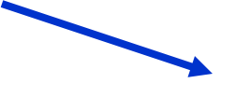
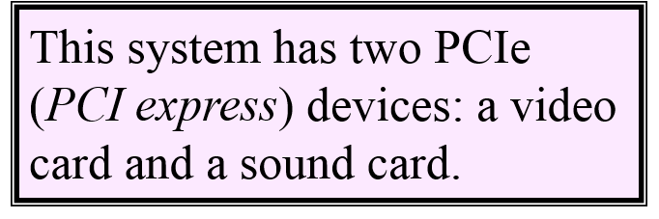
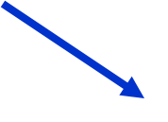
1.3 An Example System (15 of 19)

Slide 22
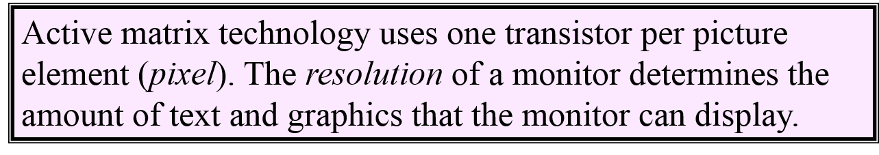
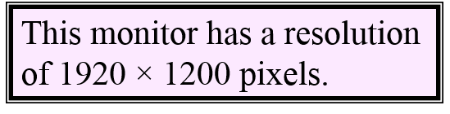


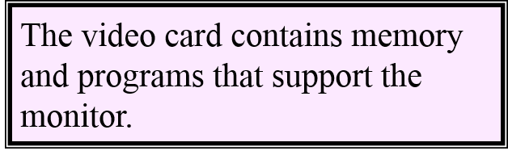
1.3 An Example System (16 of 19)

Slide 23
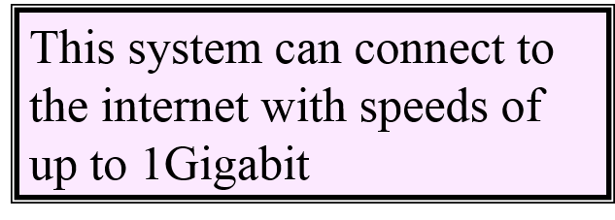

1.3 An Example System (17 of 19)

Slide 24
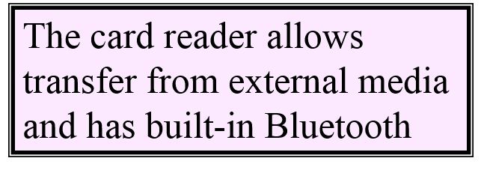
1.3 An Example System (18 of 19)

Slide 25
1.3 An Example System (19 of 19)
Throughout the remainder of the book you will see how these components work and how they interact with software to make complete computer systems.
This statement raises two important questions:
What assurance do we have that computer components will operate as we expect?
What assurance do we have that computer components will operate together?

Slide 26
1.4 Standards Organizations (1 of 4)
There are many organizations that set computer hardware standards—to include the interoperability of computer components.
Throughout this book, and in your career, you will encounter many of them.
Some of the most important standards-setting groups include the following.

Slide 27
1.4 Standards Organizations (2 of 4)
The Institute of Electrical and Electronic Engineers (IEEE)
Promotes the interests of the worldwide electrical engineering community.
Establishes standards for computer components, data representation, and signaling protocols, among many other things.

Slide 28
1.4 Standards Organizations (3 of 4)
The International Telecommunications Union (ITU)
Concerns itself with the interoperability of telecommunications systems, including data communications and telephony.
National groups establish standards within their respective countries:
The American National Standards Institute (ANSI)
The British Standards Institution (BSI)

Slide 29
1.4 Standards Organizations (4 of 4)
The International Organization for Standardization (ISO)
Establishes worldwide standards for everything from screw threads to photographic film.
Is influential in formulating standards for computer hardware and software, including their methods of manufacture.
Note: ISO is not an acronym. ISO comes from the Greek,
isos, meaning “equal.”

Slide 30
1.5 Historical Development (1 of 11)
To fully appreciate the computers of today, it is helpful to understand how things got the way they are.
The evolution of computing machinery has taken place over several centuries.
In modern times computer evolution is usually classified into four generations according to the salient technology of the era.
We note that many of the following dates are approximate.

Slide 31
1.5 Historical Development (2 of 11)
Generation Zero: Mechanical Calculating Machines (1642–1945)
Calculating Clock: Wilhelm Schickard (1592–1635)
Pascaline: Blaise Pascal (1623–1662)
Difference Engine: Charles Babbage (1791–1871), also designed but never built the Analytical Engine.
Punched card tabulating machines: Herman Hollerith (1860–1929)
Hollerith cards were commonly used for computer input well into the 1970s.

Slide 32
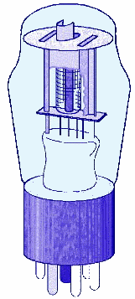
1.5 Historical Development (3 of 11)
The First Generation: Vacuum Tube Computers (1945–1953)
Atanasoff Berry Computer (1937–1938) solved systems of linear equations.
John Atanasoff and Clifford Berry of Iowa State University

Slide 33
1.5 Historical Development (4 of 11)
The First Generation: Vacuum Tube Computers (1945–1953)
Electronic Numerical Integrator and Computer (ENIAC)
John Mauchly and J. Presper Eckert
University of Pennsylvania, 1946
The ENIAC was the first general-purpose computer.

Slide 34
1.5 Historical Development (5 of 11)
The First Generation: Vacuum Tube Computers (1945–1953)
The IBM 650 first mass-produced computer (1955).
It was phased out in 1969.
Other major computer manufacturers of this period include UNIVAC, Engineering Research Associates (ERA), and Computer Research Corporation (CRC).
UNIVAC and ERA were bought by Remington Rand, the ancestor of the Unisys Corporation.
CRC was bought by the Underwood (typewriter) Corporation, which left the computer business.

Slide 35
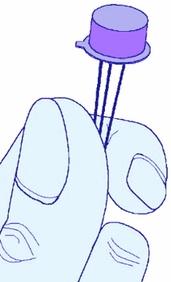
1.5 Historical Development (6 of 11)
The Second Generation: Transistorized Computers (1954–1965)
IBM 7094 (scientific) and 1401 (business)
Digital Equipment Corporation (DEC) PDP-1
Univac 1100
Control Data Corporation 1604
. . . and many others.
These systems had few architectural similarities.

Slide 36
1.5 Historical Development (7 of 11)
The Third Generation: Integrated Circuit Computers (1965–1980)
IBM 360
DEC PDP-8 and PDP-11
Cray-1 supercomputer
. . . and many others.
By this time, IBM had gained overwhelming dominance in the industry.
Computer manufacturers of this era were characterized as IBM and the BUNCH (Burroughs, Unisys, NCR, Control Data, and Honeywell).

Slide 37
1.5 Historical Development (8 of 11)
The Fourth Generation: VLSI Computers (1980–????)
Very large scale integrated circuits (VLSI) have more than 10,000 components per chip.
Enabled the creation of microprocessors.
The first was the 4-bit Intel 4004.
Later versions, such as the 8080, 8086, and 8088 spawned the idea of “personal computing.”

Slide 38
1.5 Historical Development (9 of 11)
Moore’s Law (1965)
Gordon Moore, Intel founder
“The density of transistors in an integrated circuit will double every year.”
Contemporary version:
“The density of silicon chips doubles every 18 months.”
But this “law” cannot hold forever ...

Slide 39
1.5 Historical Development (10 of 11)
Rock’s Law
Arthur Rock, Intel financier
“The cost of capital equipment to build semiconductors will double every 4 years.”
In 1968, a new chip plant cost about $12,000.
At the time, $12,000 would buy a nice home in the suburbs.
An executive earning $12,000 per year was “making a very comfortable living.”

Slide 40
1.5 Historical Development (11 of 11)
Rock’s Law
In 2012, a chip plants under construction cost well over $5 billion.
$5 billion is more than the gross domestic product of some small countries, including Barbados, Mauritania, and Rwanda.
For Moore’s Law to hold, Rock’s Law must fall, or vice versa. But no one can say which will give out first.

Slide 41
1.6 The Computer Level Hierarchy (1 of 7)
Computers consist of many things besides chips.
Before a computer can do anything worthwhile, it must also use software.
Writing complex programs requires a “divide and conquer” approach, where each program module solves a smaller problem.
Complex computer systems employ a similar technique through a series of virtual machine layers.

Slide 42
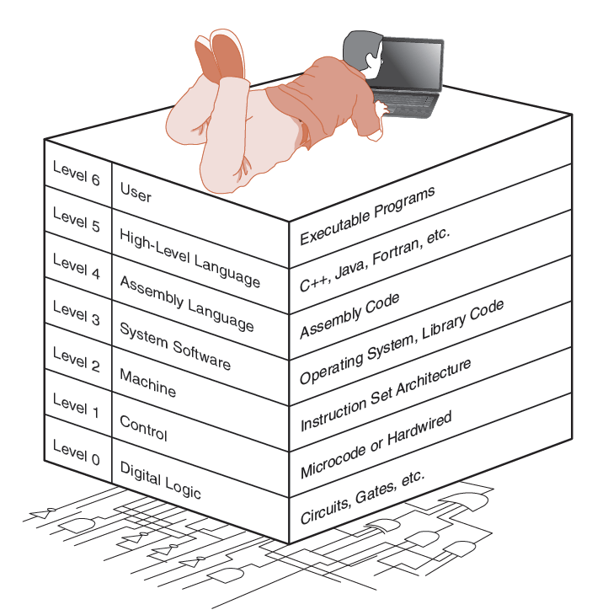
1.6 The Computer Level Hierarchy (2 of 7)
Each virtual machine layer is an abstraction of the level below it.
The machines at each level execute their own particular instructions, calling upon machines at lower levels to perform tasks as required.
Computer circuits ultimately carry out the work.

Slide 43
1.6 The Computer Level Hierarchy (3 of 7)
Level 6: The User Level
Program execution and user interface level
The level with which we are most familiar
Level 5: High-Level Language Level
The level with which we interact when we write programs in languages such as C, Pascal, Lisp, and Java.

Slide 44
1.6 The Computer Level Hierarchy (4 of 7)
Level 4: Assembly Language Level
Acts upon assembly language produced from Level 5, as well as instructions programmed directly at this level.
Level 3: System Software Level
Controls executing processes on the system.
Protects system resources.
Assembly language instructions often pass through Level 3 without modification.

Slide 45
1.6 The Computer Level Hierarchy (5 of 7)
Level 2: Machine Level
Also known as the Instruction Set Architecture (ISA) Level.
Consists of instructions that are particular to the architecture of the machine.
Programs written in machine language need no compilers, interpreters, or assemblers.

Slide 46
1.6 The Computer Level Hierarchy (6 of 7)
Level 1: Control Level
A control unit decodes and executes instructions and moves data through the system.
Control units can be microprogrammed or hardwired.
A microprogram is a program written in a low-level language that is implemented by the hardware.
Hardwired control units consist of hardware that directly executes machine instructions.

Slide 47
1.6 The Computer Level Hierarchy (7 of 7)
Level 0: Digital Logic Level
This level is where we find digital circuits (the chips).
Digital circuits consist of gates and wires.
These components implement the mathematical logic of all other levels.

Slide 48
1.7 Cloud Computing: Computing as a Service (1 of 6)
The ultimate aim of every computer system is to deliver functionality to its users.
Computer users typically do not care about terabytes of storage and gigahertz of processor speed.
Many companies outsource their data centers to third-party specialists, who agree to provide computing services for a fee.
These arrangements are managed through service-level agreements (SLAs).

Slide 49
1.7 Cloud Computing: Computing as a Service (2 of 6)
Rather than pay a third party to run a company-owned data center, another approach is to buy computing services from someone else’s data center and connect to it via the Internet.
This is the idea behind a collection of service models known as Cloud computing.
The “Cloud” is a visual metaphor traditionally used for the Internet. It is even more apt for service-defined computing.

Slide 50
1.7 Cloud Computing: Computing as a Service (3 of 6)
More Cloud computing models:
Software as a Service, or SaaS. The consumer of this service buy application services
Well-known examples include Gmail, Dropbox, GoToMeeting, and Netflix.
Platform as a Service, or PaaS. Provides server hardware, operating systems, database services, security components, and backup and recovery services.
Well-known PaaS providers include Google App Engine and Microsoft Windows Azure Cloud Services.

Slide 51
1.7 Cloud Computing: Computing as a Service (4 of 6)
The general term, Cloud computing, consists of several models:
Infrastructure as a Service (IaaS) provides only server hardware, secure network access to the servers, and backup and recovery services. The customer is responsible for all system software including the operating system and databases.
Well-known IaaS platforms include Amazon EC2, Google Compute Engine, Microsoft Azure Services Platform, Rackspace, and HP Cloud.

Slide 52
1.7 Cloud Computing: Computing as a Service (5 of 6)
More Cloud computing models:
Infrastructure as a Service (IaaS) provides only server hardware, secure network access to the servers, and backup and recovery services. The customer is responsible for all system software including the operating system and databases.
Well-known IaaS platforms include Amazon EC2, Google Compute Engine, Microsoft Azure Services Platform, Rackspace, and HP Cloud.
Cloud storage is a limited type of IaaS that includes services such as Dropbox, Google Drive, and Amazon.com’s Cloud Drive.

Slide 53
1.7 Cloud Computing: Computing as a Service (6 of 6)
Cloud computing relies on the concept of elasticity where resources can be added and removed as needed.
You pay for only what you use.
Virtualization is an enabler of elasticity.
Instead of having a physical machine, you have a “logical” machine that may span several physical machines, or occupy only part of a single physical machine.
Potential issues: Privacy, security, having someone else in control of software and hardware you use

Slide 54
1.8 The Fragility of the Internet (1 of 2)
Practically everyone understands that the Internet is crucial to global commerce.
What is less clear is the importance of the Internet to the health and safety of the modern world.
SCADA (supervisory control and data acquisition) systems operate vital portions of our physical infrastructure including:
Power generation
Transportation networks
Sewage systems
Oil and gas pipelines

Slide 55
1.8 The Fragility of the Internet (2 of 2)
Reliance on the Internet as a physical infrastructure is only going to increase with the Internet of Things (IoT) or Machine-to-Machine (M2M) communication.
Cisco estimates 50 billion sensor nodes by 2020
Can the Internet deal with this traffic? Congestive collapse is a concern.
Congestive collapse: routers become overwhelmed, reroute packets to other routers which then become overwhelmed in cascading fashion.
The ultimate fix is to make the Internet “smarter,” but this won’t happen quickly. Until then, we worry.

Slide 56
1.9 The von Neumann Model (1 of 8)
On the ENIAC, all programming was done at the digital logic level.
Programming the computer involved moving plugs and wires.
A different hardware configuration was needed to solve every unique problem type.
Configuring the ENIAC to solve a “simple” problem required many days labor by skilled technicians.

Slide 57
1.9 The von Neumann Model (2 of 8)
Inventors of the ENIAC, John Mauchley and J. Presper Eckert, conceived of a computer that could store instructions in memory.
The invention of this idea has since been ascribed to a mathematician, John von Neumann, who was a contemporary of Mauchley and Eckert.
Stored-program computers have become known as von Neumann Architecture systems.

Slide 58
1.9 The von Neumann Model (3 of 8)
Today’s stored-program computers have the following characteristics:
Three hardware systems:
A central processing unit (CPU)
A main memory system
An I/O system
The capacity to carry out sequential instruction processing.
A single data path between the CPU and main memory.
This single path is known as the von Neumann bottleneck.

Slide 59
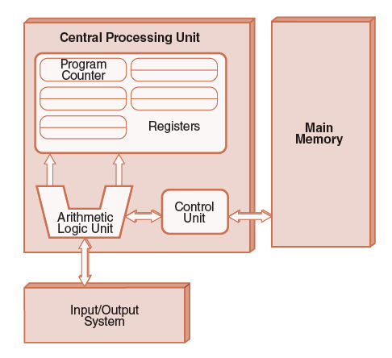
1.9 The von Neumann Model (4 of 8)
This is a general depiction of a von Neumann system:
These computers employ a fetch-decode-execute cycle to run programs as follows . . .

Slide 60
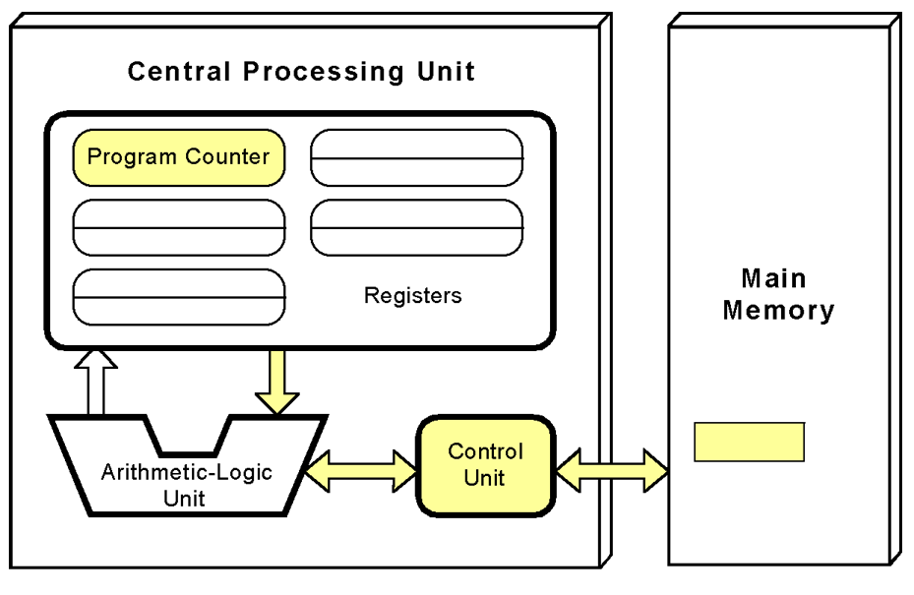
1.9 The von Neumann Model (5 of 8)
The control unit fetches the next instruction from memory using the program counter to determine where the instruction is located.

Slide 61
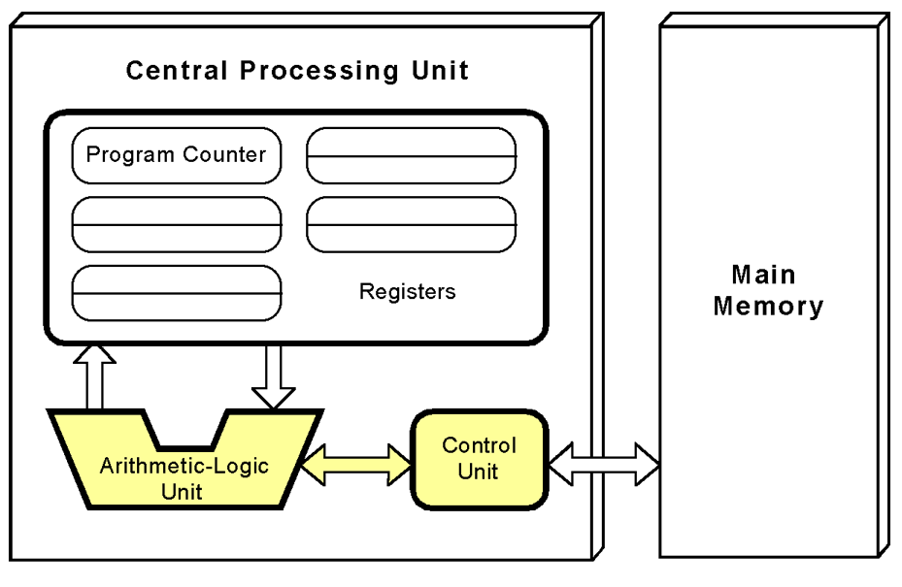
1.9 The von Neumann Model (6 of 8)
The instruction is decoded into a language that the ALU can understand.

Slide 62
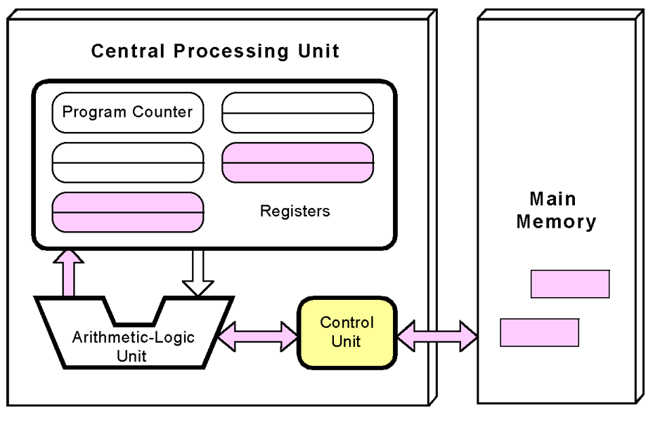
1.9 The von Neumann Model (7 of 8)
Any data operands required to execute the instruction are fetched from memory and placed into registers within the CPU.

Slide 63
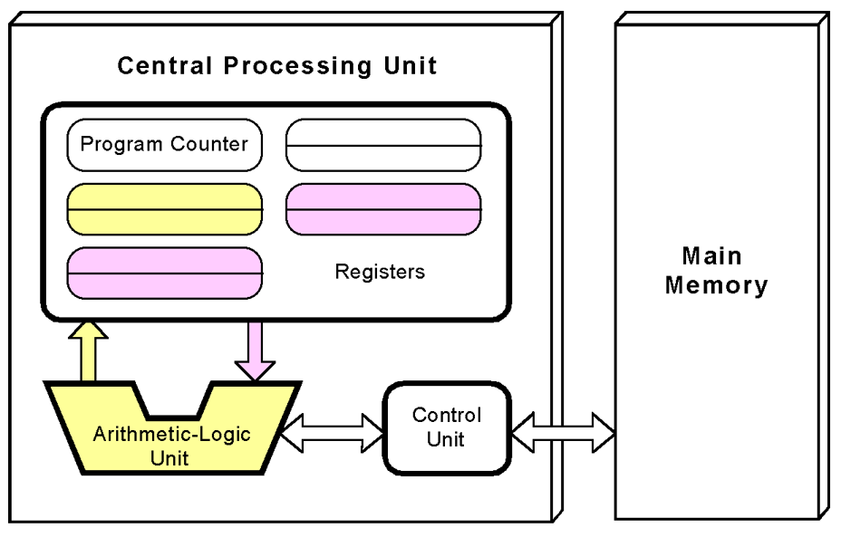
1.9 The von Neumann Model (8 of 8)
The ALU executes the instruction and places results in registers or memory.

Slide 64
1.10 Non–von Neumann Models (1 of 2)
Conventional stored-program computers have undergone many incremental improvements over the years.
These improvements include adding specialized buses, floating-point units, and cache memories, to name only a few.
But enormous improvements in computational power require departure from the classic von Neumann architecture.
Adding processors is one approach.

Slide 65
1.10 Non–von Neumann Models (2 of 2)
Some of today’s systems have separate buses for data and instructions.
Called a Harvard architecture
Other non-von Neumann systems provide special-purpose processors to offload work from the main CPU.
More radical departures include dataflow computing, quantum computing, cellular automata, and parallel computing.

Slide 66
1.11 Parallel Computing (1 of 3)
In the late 1960s, high-performance computer systems were equipped with dual processors to increase computational throughput.
In the 1970s, supercomputer systems were introduced with 32 processors.
Supercomputers with 1,000 processors were built in the 1980s.
In 1999, IBM announced its Blue Gene system containing over 1 million processors.

Slide 67
1.11 Parallel Computing (2 of 3)
Parallel processing allows a computer to simultaneously work on subparts of a problem.
Multicore processors have two or more processor cores sharing a single die.
Each core has its own ALU and set of registers, but all processors share memory and other resources.
“Dual core” differs from “dual processor.”
Dual-processor machines, for example, have two processors, but each processor plugs into the motherboard separately.

Slide 68
1.11 Parallel Computing (3 of 3)
Multi-core systems provide the ability to multitask (e.g., browse the Web while burning a CD).
Multithreaded applications spread mini-processes, threads, across one or more processors for increased throughput.
New programming languages are necessary to fully exploit multiprocessor power.

Slide 69
Conclusion
This chapter has given you an overview of the subject of computer architecture.
You should now be sufficiently familiar with general system structure to guide your studies throughout the remainder of this course.
Subsequent chapters will explore many of these topics in great detail.

